Slide 1

NUTRITION GUIDE
The recipe page,
ready to take an order.
Eight videos. The jar that matches the dish is on the same row.

Slide 2
WHAT THAT PAGE DOES TODAY
People can watch.
They cannot buy.
Eight videos
The live guide is a wall of recipes. The page ends there.
No jar on the row
A viewer who wants the seasoning has to go find the shop.
The visit ends
The recipe did its job. The shop never got the chance.
MYALCHE · Nutrition Guide
2

Slide 3
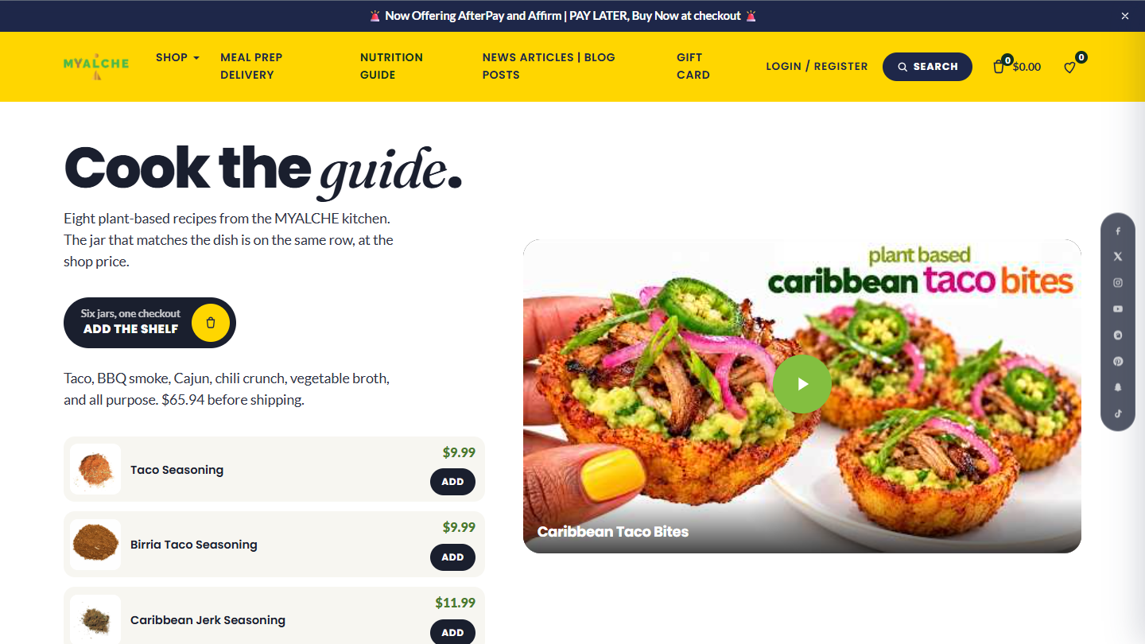

Slide 4
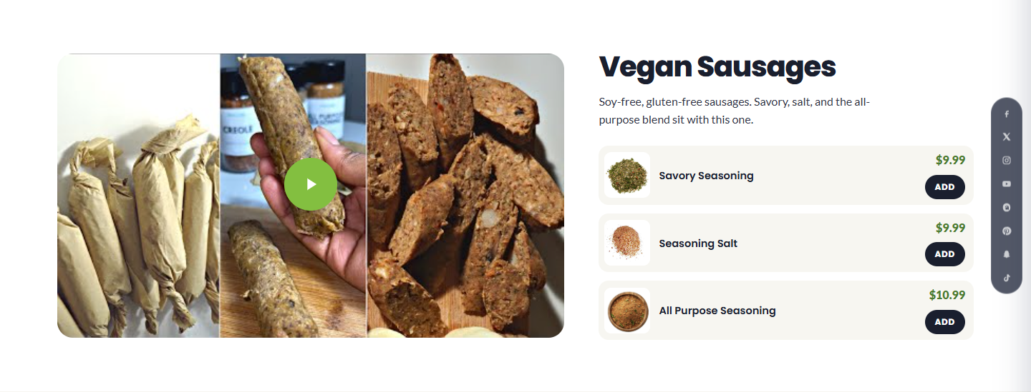
THE JAR STAYS WITH THE DISH
Shop price. Add on the same row.
MYALCHE · Nutrition Guide
4

Slide 5
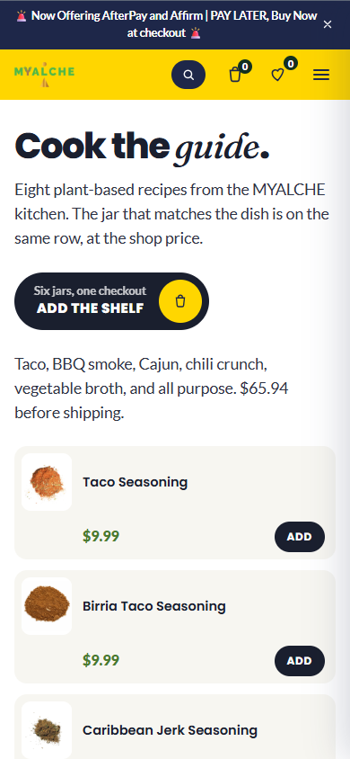
ON A PHONE, NOTHING FALLS OFF
The same page.
The menu takes over.
1
Search, cart, and the menu stay in the yellow bar.
2
One button adds the six-jar shelf. $65.94, before shipping.
3
That cart is the cart already used on the shop.
MYALCHE · Nutrition Guide
5

Slide 6
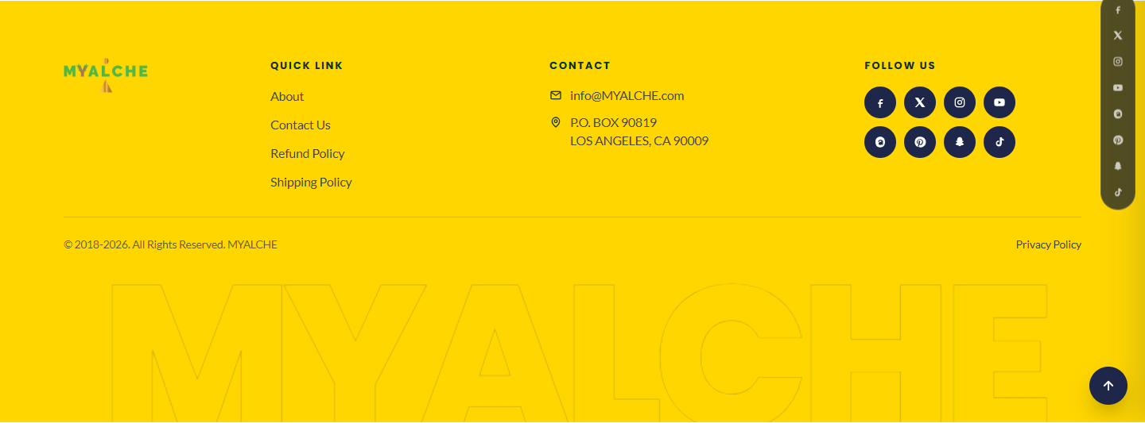
THE FOOTER ALREADY ON THE HOME REDESIGN
Logo, links, address, and the social row. One chrome for the whole site.

